Slide 1

Fruit of the Loom
CiCLO™ Polyester Sweatshirts
Sustainable innovation beyond greenwashing
21.10.2025

Slide 2
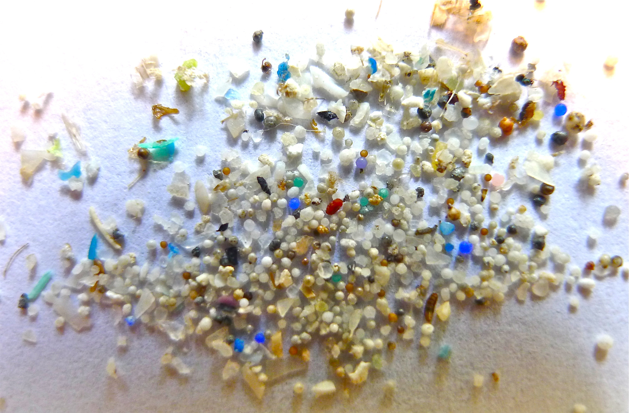
The Microplastic Problem
35% of ocean microplastics come from synthetic textiles
65% of global textiles are synthetic, contributing to pollution
Up to 18 million microfibers can shed from a load of synthetic garments in one wash cycle
44M pounds of synthetic textiles end up in landfills daily

Slide 3



How CiCLO™ Works & Features
Patented technology integrated directly into polyester fibres
Biodegradable Pathways
Drop‑in, High Performance
Safe & Circular
Additive (~2%) creates spots within fibre
Microbes penetrate & consume polymer
Biodegradation triggers only in moist, microbe-rich environments
No change to manufacturing processes
Maintains durability, dyeability & recyclability
Seamlessly blends with traditional or recycled polymers
Certified non‑toxic (OEKO‑TEX®, REACH)
Works with rPET & bio‑based polymers
Supports circularity & reduces microplastic persistence

Slide 4

Biodegradation Proof & Benefits
Why it matters
≥90% biodegradation within ~4 years
Tested via ASTM/ISO; remaining residue becomes biomass
Retains performance like cotton; fully recyclable
Reduces microplastic persistence & supports circular economy
Certified non‑toxic & compliant with OEKO‑TEX® & REACH

Slide 5
Comparative Biodegradation Times
Material | Approx. biodegradation time
Cotton | 30–90 days (30–90% decomposition in 15–90 days)
Wool | ≈15 weeks (95% biodegradation)
CiCLO™ Polyester | 2.6–3.7 years (≥90% biodegradation)
Conventional Polyester | 20–200 years (non-biodegradable)
Recycled Polyester (rPET) | Not biodegradable; still plastic

Slide 6
CiCLO™ vs Recycled Polyester
CiCLO™ Polyester
Recycled Polyester (rPET)
Biodegradable: ≥90% in 2.6–3.7 years
Reduces microplastic persistence
Maintains durability & recyclability
Non-toxic & regulation ready (OEKO‑TEX®, REACH)
Drop‑in solution compatible with rPET & bio‑based polymers
Integrated at the polymer stage – no energy‑intensive recycling processes required
Reuses plastic & reduces emissions
Still plastic: not biodegradable, releases microfibers
Quality declines each recycling cycle
Requires resource‑intensive processing: washing, sorting & remelting; chemical recycling uses high temperatures & energy
‘Ocean plastic’ often means beach‑collected PET bottles; marine‑litter clothing still sheds microplastics & ends in landfill

